Slide 1
AstroEngr 331X
The Space Environment:
Freefall & Vaccuum
May 2024

Slide 2
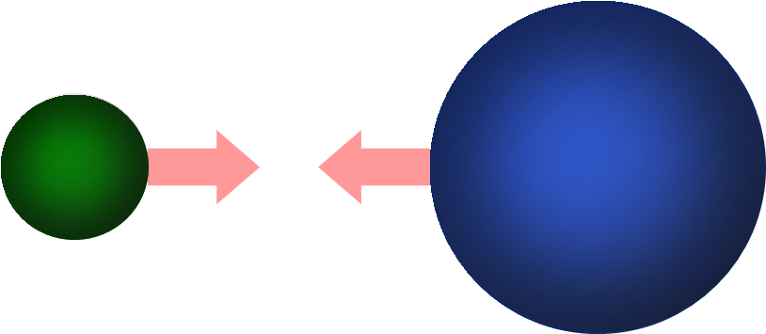
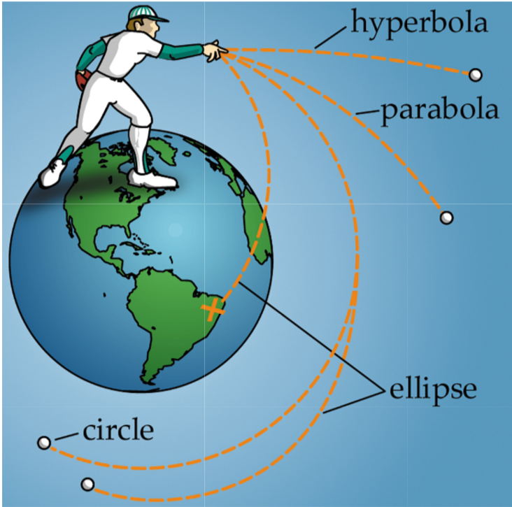
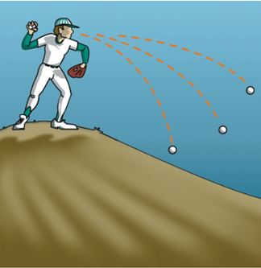
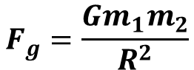
Free Fall Environment
NOT “Zero Gravity”
$$F_{g}=\frac{Gm_{1}m_{2}}{R^{2}}$$

Slide 3
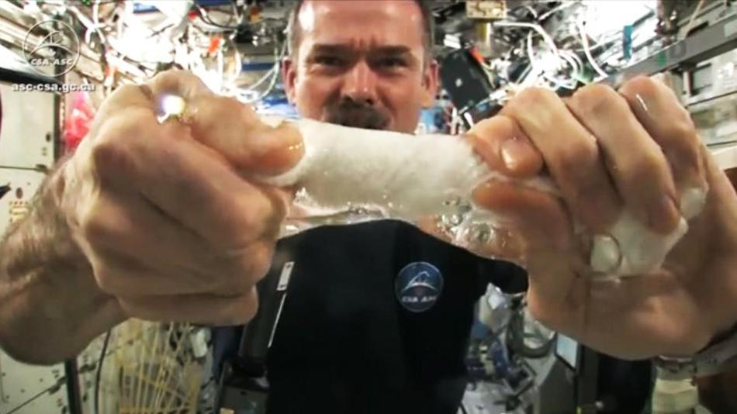
Free Fall Environment
Effects on Spacecraft
Useful:
No contact forces – structural loads are minimal
Problematic:
Fluid measurement and delivery are more difficult
Fuel

Slide 4
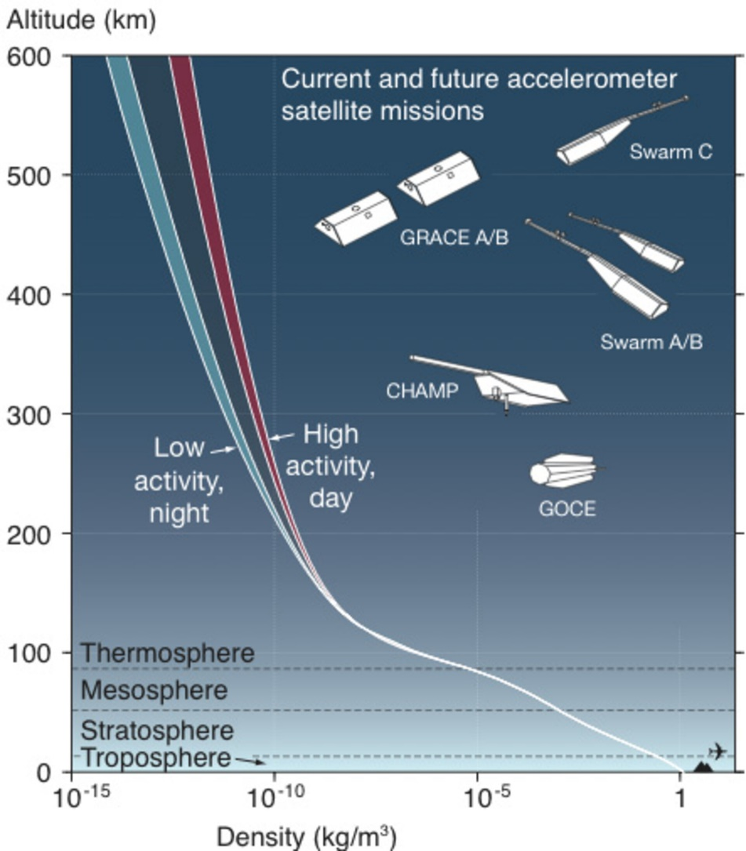
Earth’s Atmosphere
https://www.esa.int/ESA_Multimedia/Images/2009/06/Atmospheric_density_changes_with_altitude

Slide 5
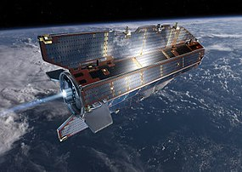
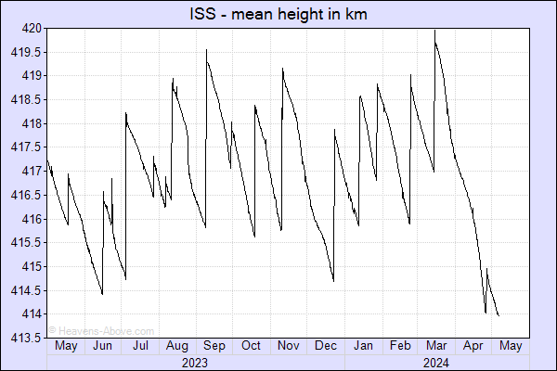
Atmospheric Drag
Drag
Difficult to predict
Can lead to re-entry/end of mission
Negligible above ~600 km
Impact on satellite design:
Lower bound on orbital altitude
Propulsion system must be designed to counteract drag
Shape/orientation can be designed to have desired properties
Differential drag for formation flying

Slide 6
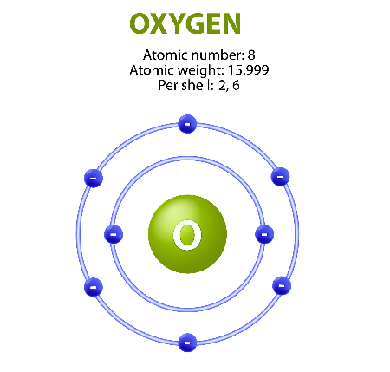
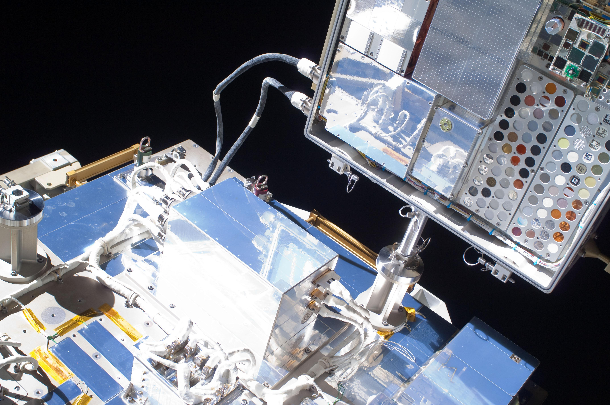
Atomic Oxygen
Atomic Oxygen
At high altitude, O2 molecules are split by radiation and charged particles
Low density leads to atomic oxygen (“O”) persisting rather than immediately recombining to molecular form
Impact on satellite design:
“O” can
Weaken structures through oxidation
Change properties of coatings
Degrade sensors
Materials must be chosen to limit these effects
Notes:
Skylab example

Slide 7
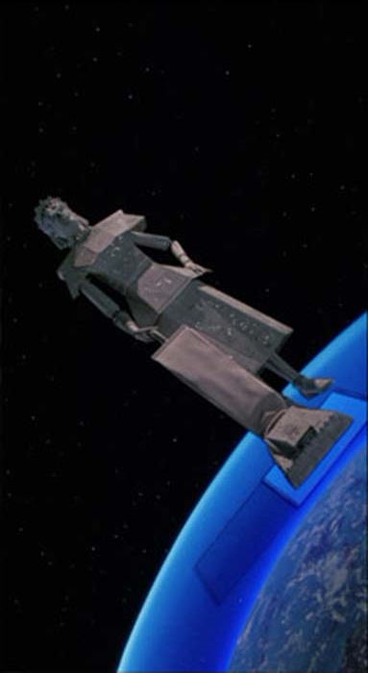
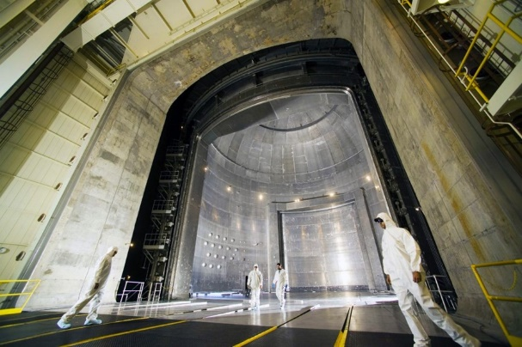
Near-Vacuum
The lack of a dense atmosphere in space also impacts spacecraft design!
Effect Description Design Impact
Outgassing
Materials release trapped gases
Choose materials carefully, thermal-vac testing prior to launch
Cold welding
No “air pocket” between moving parts
Try to limit moving parts
Limited heat transfer
Radiation is the only method to transfer heat into/out of the spacecraft
Thermal system and materials must be designed carefully balance radiative heat transfer in/out
No O2 to enable combustion
Propulsion system cannot rely on atmospheric oxygen
Oxidizer must be carried on-board if relying on chemical means of propulsion
Notes:
Can use to our advantage.

Slide 8
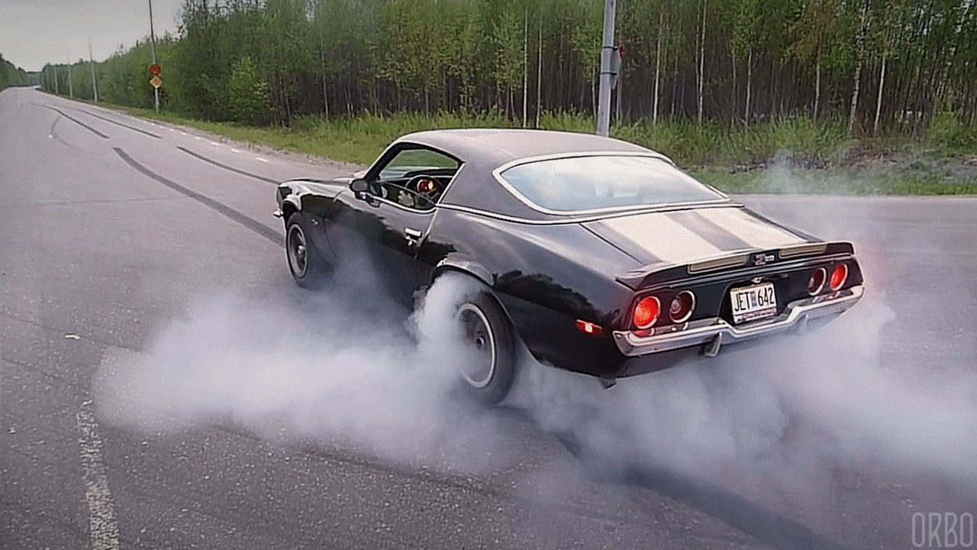
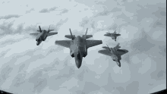
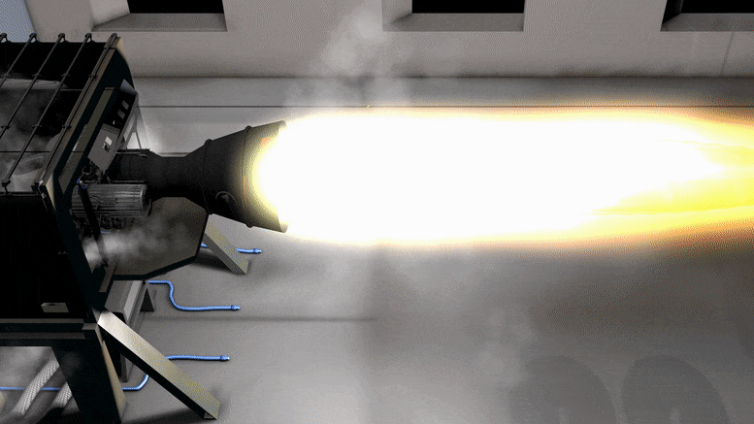
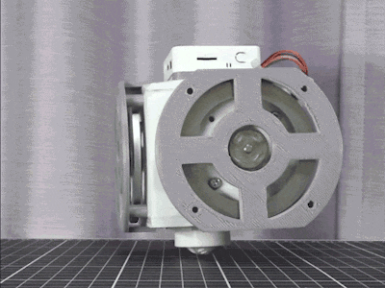
Near-Vacuum: Impact on spacecraft motion
Spacecraft cannot utilize contact with external mass to accelerate or rotate
To accelerate (or rotate) spacecraft must expel mass or exchange energy

